Slide 1
Gulp – A task runner

Slide 2
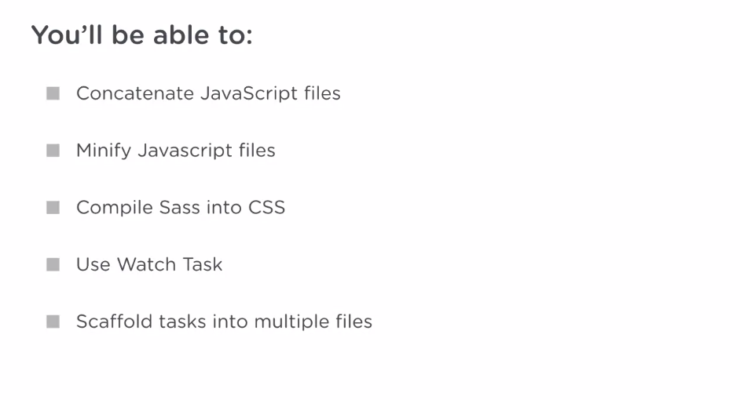

Slide 3
Why Gulp
Gulp is the engine that can run individual, predefined tasks.
And these tasks could be just about anything from compiling Sass to CSS and serving these files in development to minifying CSS and JavaScript to create smaller files for production environments.
Tasks are typically defined in a JavaScript file or set of files.

Slide 4
Why Gulp
These tasks can then be called and run by the Gulp engine and these tasks can run one after the other, where later tasks depend on the earlier tasks.
Tasks can also be run all at the same time in parallel.
For instance, Gulp can concatenate scripts at the same time it compiles Sass into CSS. This is because the two tasks don't depend on each other at all.
Notes:
We'll refer to the task setups as pipelines. Gulp is used to manage some pretty sophisticated task pipelines.

Slide 5
Installing Gulp
Gulp is a Node.js technology and so, you need Node and Node package manager installed on your machine.
To see if Node and npm are installed, you can run
node -v
npm -v
I can use Node's HTTP server from the project directory.
run “http-server”
If you don’t have http-server run “npm install -g http-server”
It’s recommended to change the port to 3000 using -p flag
http-server -p 3000
Notes:
And, this serves a site on port 8080 on my machine. But, it's more conventional to serve Node applications on port 3000. So, I'll add the p flag and the 3000 option to serve the site on port 3000.

Slide 6
Installing Gulp
gulp is a Node module and in order to add gulp to our project, we have to create a package.json file that lists the project's Node dependencies.
The package.json file also contains information, like the version of our project and the URL for the GitHub repo, where the project is. Let's create the package.json file by running the command npm init.
Let's install gulp by running npm install gulp --save-dev
Notes:
Gulp is not used by our app directly and in fact, the app does not need gulp to run. Our application is a static website of JavaScript and styles, and can be run by any static server. gulp will almost never need to be installed on our production servers. Therefore, we list it as a development-only dependency.

Slide 7
Installing Gulp Globally
You'll also want to install gulp globally by running npm install --global gulp.
The reason we installed globally is so that it's available system wide. The system wide installation of gulp will manage the local dependencies of gulp in each of your projects.

Slide 8
Your First Gulp Task
Load the gulp module by requiring it and assigning it to the variable gulp.
var gulp = require (‘gulp’);
The final thing that Gulp needs is for us to define a task. To do this, we're going to use Gulp's task method.
The task method will receive the name of a task as the first parameter. And it takes an anonymous function as the second parameter.

Slide 9
First Task
Instead of providing a function as a second parameter, I'm going to provide an array of dependencies. Now, we only have one other task defined so far. We're gonna make that task a dependency of the default task.
When we say dependency, what we mean is that Gulp is going to run every dependency before it starts running the default task.
And now for the work of our default task, we'll add another callback function,

Slide 10
Gulp Plugins
Plugins are incredibly useful, because they cover almost all of the things you could ever want to do with your application, either in development, or in production.
You should rarely, if ever, have to build these tasks from scratch. People have built plugins that do things from compiling sass, to pushing static sites, to get hub pages.

Slide 11
gulp-concat.
The gulp-concat package concatenates, or combines multiple file, into one file. This is great for turning a bunch of CSS or JavaScript files into just one.
npm install gulp-concat –save-dev

Slide 12
gulp.src
gulp.src can take an array of file names or a string of a single file.
Since there are multiple files we're going to use an array. And we'll list the three files in the order that I want to concatenate them.
Now sometimes the load order of the scripts does not matter, and in this case it does.
The gulp.source method works by creating what's called a readable stream of data. This stream is an in-memory piece of data that can be used by the application.
Notes:
In this case it matters that the jQuery code comes before the jQuery sticky plugin. Additionally, our custom code in main.js depends on both of these, and so it needs to come last.

Slide 13
.pipe
pipe() sends the readable stream of data to our concat task.
The concat task takes a string parameter, which will be the name of the file we create. In our case, this is going to be app.js.

Slide 14
gulp.dest
Now finally, I will pipe that file to its destination using the gulp.dest method.
The gulp.dest method is the one that takes a readable stream of data and actually persists it, or writes it, to disk.
In this case, we'll give the gulp.dest method a string parameter. This will be the folder that we want the result of our concat task to end up in. Since we want the file in the JS folder, I'll provide that as the parameter.

Slide 15
Minifying JavaScript Files
Minification is the process that compresses your JavaScript file, eliminating extra space. And in some cases the minification process even renames variables to make the code more performant.
These performance improvements can reduce bandwidth used by your site and improve the overall user experience through quicker downloads and an overall faster application.
In order to have gulp minify JavaScript files we're going to install another third party gulp module called gulp-uglify.

Slide 16
gulp-rename
With one line of code, we can rename the original file from app.js to app.min.js.
We can do that by piping the results of the uglify task to the rename method.
And then the parameter we provide to the rename method is going to be the name of the new file that we wanna create. we'll call that app.min.js.

Slide 17
Turn Sass into CSS, automatically
npm install gulp-sass –save-dev

Slide 18
Add Source Maps to your SaSS
Source maps are an awesome way to save yourself time and frustration.
npm install gulp-sourcemaps –save-dev
After we grab our application.sass source file with gulp, we’re going to pipe it to the maps.init method.
The maps module is going to do the second part of its work with the write method. The write method takes one parameter, which is going to be the current working directory relative to the gulp.dest directory.
Notes:
And just to reiterate, this path is going to be relative to our output directory.

Slide 19
Source maps for JavaScript
The same plug in we use to create our Sass source maps, can be used to create JavaScript source maps as well.

Slide 20
Putting Multiple Tasks Together
gulp.task('build', ['minifyScripts', 'compileSass']);
gulp.task('minifyScripts', ['concatScripts'], function () => {});
We can define an array of dependencies for the task and multiple dependency tasks will run in parallel(order doesn’t matters).

Slide 21
Automatically Run Tasks with Gulp’s Watch Method
The watch method, just like it sounds, watches files for changes and then runs tasks.
This is incredibly useful, it allows you to write code and save files. You just work and Gulp compiles Sass, creates source maps, refreshes your browser or does any number of other tasks.
Notes:
We don't need to use a return statement. Without getting too detailed about it, just remember that if other tasks don't depend on a given task, you don't need to return anything from its callback.

Slide 22
Automatically Run Tasks with Gulp’s Watch Method
In the gulp.watch method, we’re going to provide the file to be watched as the first parameter.
The first way would be to provide in an array of files.
Other way is Gulp globbing pattern.
A globbing pattern is simply a syntax for matching the names of files.
First parameter can be an array or the string, if you're using a single globbing pattern.

Slide 23
Build and Development Pipeline

